Slide 1

Module 4: Curriculum and Learning Environments
Power point 1

Slide 2
Objective
The student will describe environments which nurture children and stimulate learning.

Slide 3
Discussion Qs for groups
What are the components that make a good early learning environment?
What is needed in a good outdoor environment?

Slide 4
A child-centered environment consists of several elements:
Staff working closely with children, observing them carefully, and following their lead when possible.
Stimulating, challenging activities available throughout the day.
Program scheduling, physical layout, and procedures that are best for the children in that space
Children choosing activities

Slide 5
Points to Consider when designing curriculum
Providers need to plan for individual differences when scheduling activities for groups of children.
Each child is on his/her own timetable for growth and development.
What may be a risky temptation for one child may never even be noticed by another child.

Slide 6

Providers should also be aware that:
The developmental range in the same-age group may be two years or more.
Individual children may have unique interests or skills outside the age range of the group.
Children with special needs may require certain activities to be modified.

Slide 7
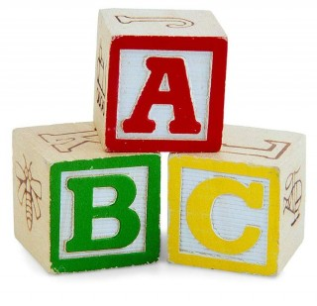
Examples of some of the interest centers that could be included in an early learning space include:
Blocks
Outdoor/large muscles area
Creative Art
Music
Dramatic play
Sensory exploration
Library/quiet area
Literacy/writing
Table toys/manipulatives
Science
Computer
Woodworking/building area

